Slide 1

115.113 Lecture 4
Inflation, Unemployment and Monetary Policy

Slide 2
Recap
Fiscal Policy

Slide 3
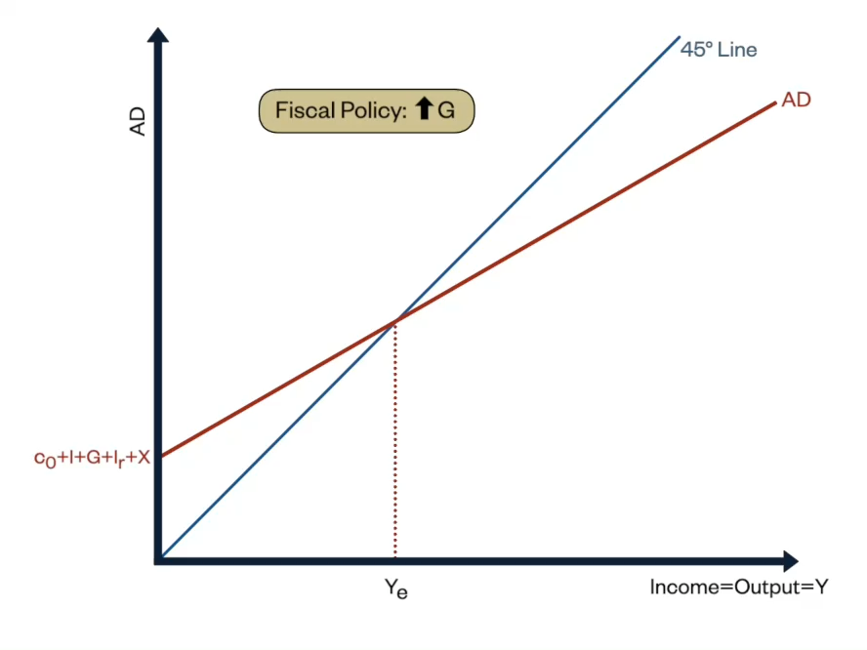
Recap
In a recession, Governments can use a fiscal stimulus to increase growth.
This means increasing G and/or reducing t

Slide 4
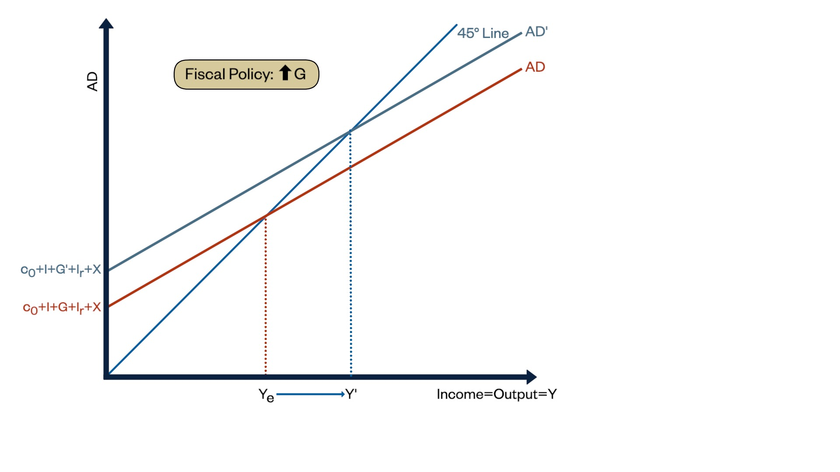
Increasing G
Any increase in any autonomous (exogenous) item in the AD equation will increase Y

Slide 5
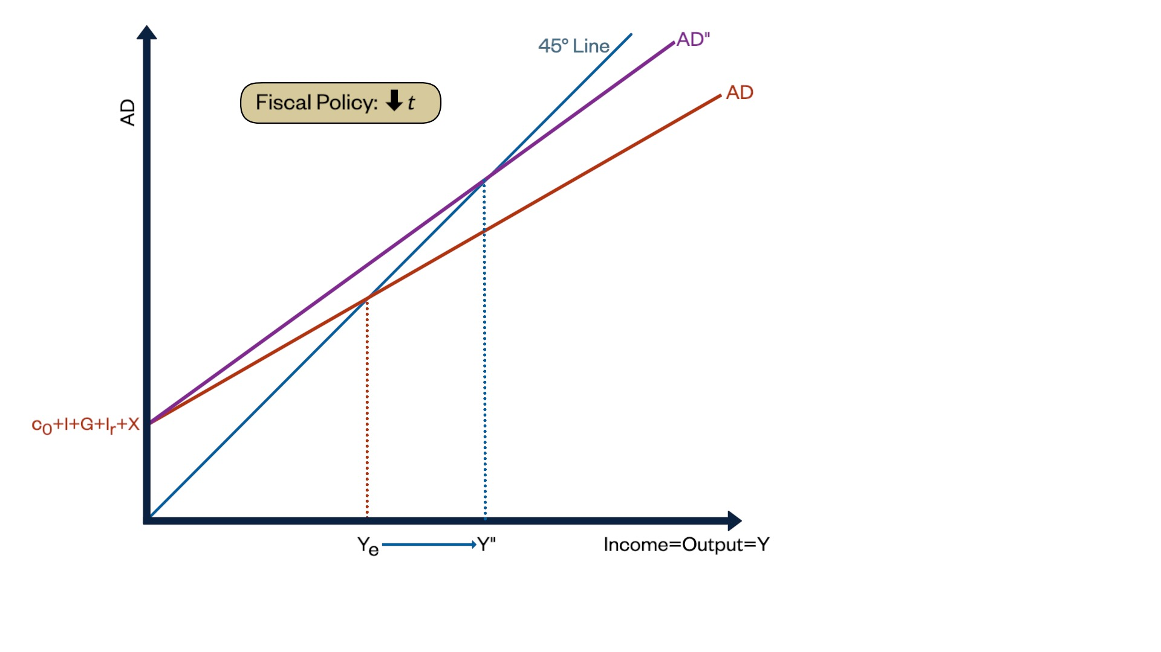
Multiplier
Any reduction in t or m, increases Y
Any increase in c₀, increases Y
The terms t or m have an overall positive sign in the multiplier denominator
The term c₀ has a negative sign

Slide 6
Quiz 1
Revision

Slide 7
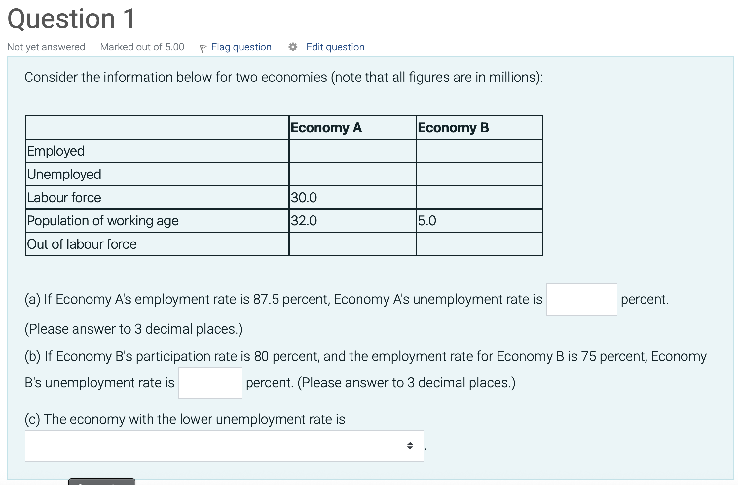
Question 1
Recall:
U/E Rate = unemployed/labour force
Participation Rate = labour force/working age population
Employment rate = Employed/working age population

Slide 8
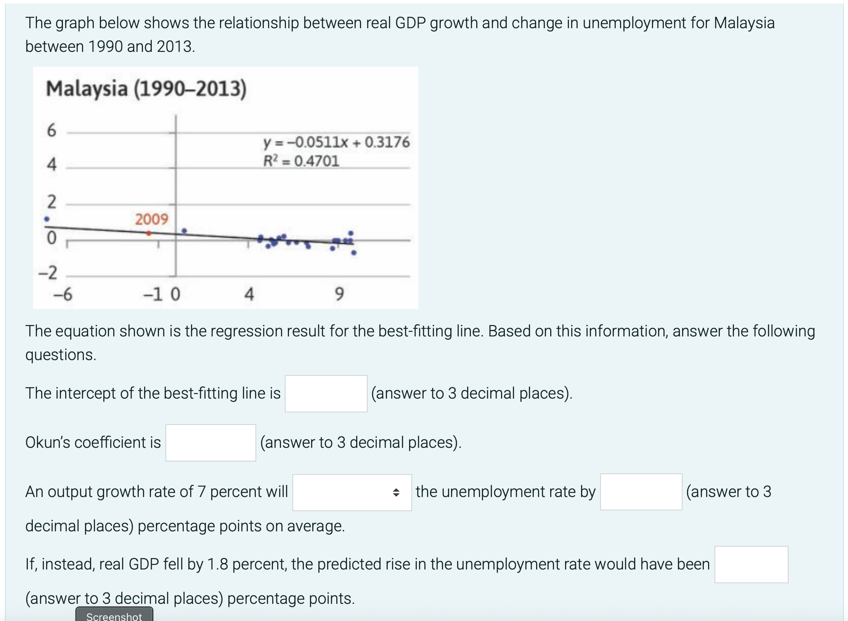
Question 2

Slide 9
Quiz 1
Question 1

Slide 10
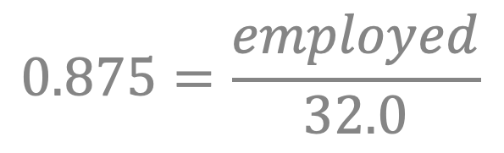
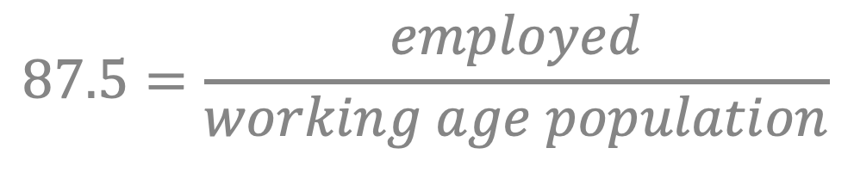
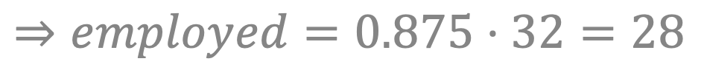
Economy A’s Employed
$$87.5=\frac{employed}{working age population}$$
$$0.875=\frac{employed}{32.0}$$
$$⇒employed=0.875⋅32=28$$
Labour force = employed + unemployed
∴ Unemployed = Labour Force - Employed

Slide 11
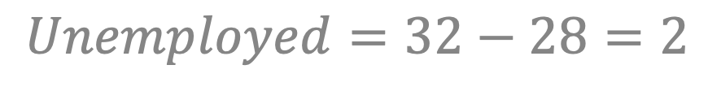
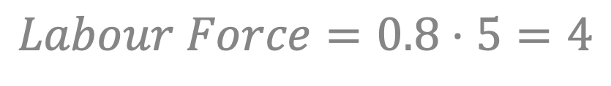
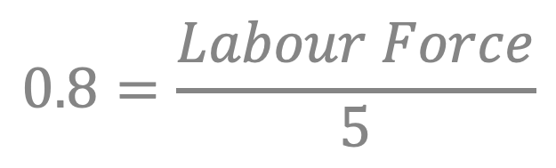
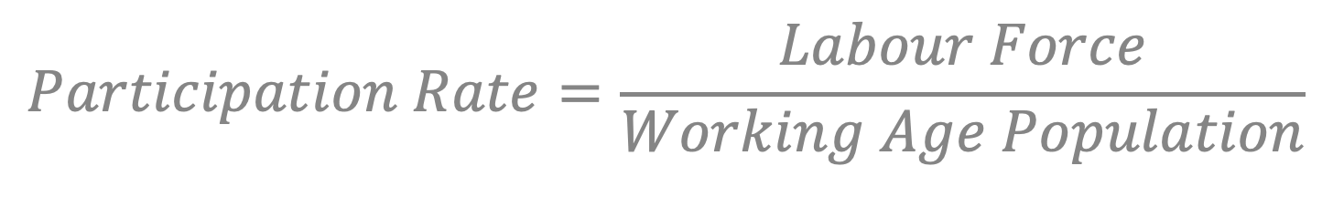
Substituting
$$Unemployed=32−28=2$$
$$Unemployment Rate=2÷30=6.667\%$$
Economy B
$$Participation Rate=\frac{Labour Force}{Working Age Population}$$
$$0.8=\frac{Labour Force}{5}$$
$$Labour Force=0.8⋅5=4$$

Slide 12
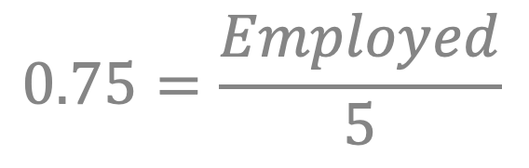

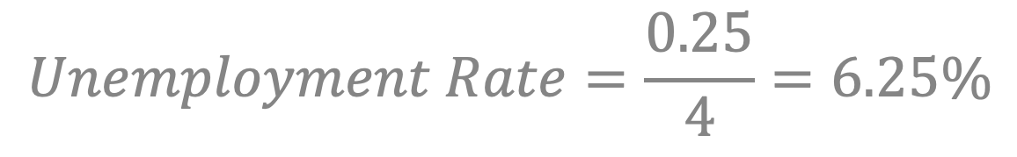
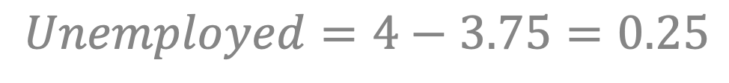
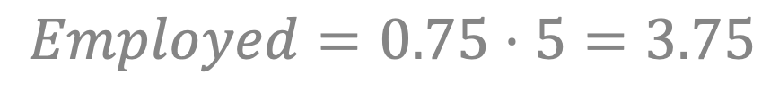
$$Employment Rate=\frac{Employed}{Working Age Population}$$
$$0.75=\frac{Employed}{5}$$
$$Employed=0.75⋅5=3.75$$
$$Unemployed=4−3.75=0.25$$
$$Unemployment Rate=\frac{0.25}{4}=6.25\%$$
B has lowest unemployment rate

Slide 13
Quiz 1
Question 2

Slide 14
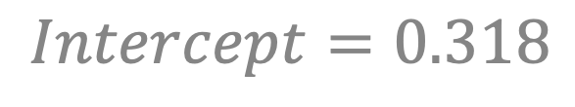
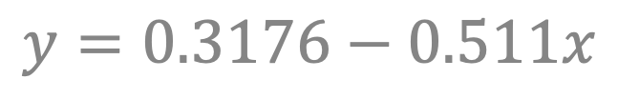
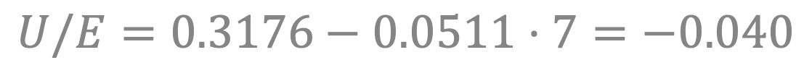
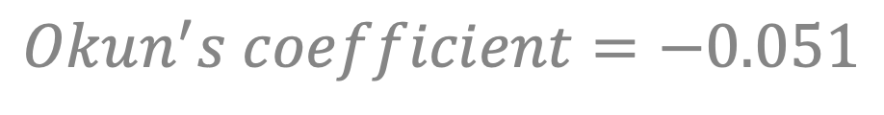
Malaysia and Okun’s Law
$$y=0.3176−0.511x$$
$$Intercept=0.318$$
$$Okun^{′}s coefficient=−0.051$$
Suppose GDP growth (x) ⬆︎7%
$$U/E=0.3176−0.0511⋅7=−0.040$$
⊖
Suppose GDP growth (x) ⬇︎1.8%
$$U/E=0.3176−0.0511⋅−1.8=0.410$$
⊕

Slide 15
Inflation
What is it?

Slide 16
An increase in the general price level in the economy. Usually measured over a year.
Inflation Definition

Slide 17
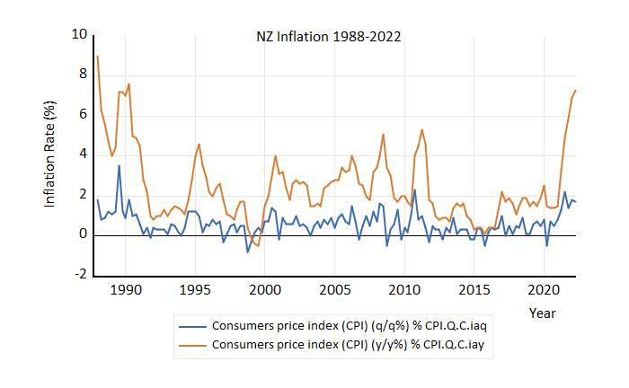
NZ Inflation

Slide 18
Inflation
Zero inflation =
A constant price level from year to year
Deflation =
A decrease in the general price level
Disinflation =
A decrease in the rate of inflation
Ways we can describe inflation

Slide 19
What’s wrong with inflation?
For people on fixed nominal income higher inflation means lower real value of income.
Inflation reduces the real value of debt
Good for borrowers, bad for creditors.
Inflation has costs.
Some people benefit from inflation

Slide 20
Inflation: Key Concepts
The Fisher equation:
Real interest rate = Nominal interest rate – Inflation rate
or
r = i – π
The real interest rate corrects for inflation.

Slide 21
What’s wrong with inflation?
High rate of inflation makes the economy work less well:
High inflation is often volatile → uncertainty
Produces struggle to distinguish between changes in relative prices and inflation
menu costs as firms have to update their prices more frequently
High inflation rates tend to reduce GDP growth.
Markets make more “mistakes” allocating resources

Slide 22
What’s wrong with deflation?
Deflation could have even more dramatic consequences than high inflation.
Households will postpone consumption (particularly of durables) because they expect goods will be cheaper in the future.
Deflation can reduce Aggregate Demand

Slide 23
What’s wrong with deflation?
Deflation also increases the real debt burden,
This is similar to a negative shock to aggregate demand.
which may lead households to cut consumption to return to their target wealth.
Changes to wealth and expectations cause a consumption shock to the economy

Slide 24
The Phillips Curve
02.
Inflation and Unemployment

Slide 25

Bill Phillips
NZ Economist
Also was a crocodile hunter in Australia, an engineer, and a pilot during World War Two

Slide 26
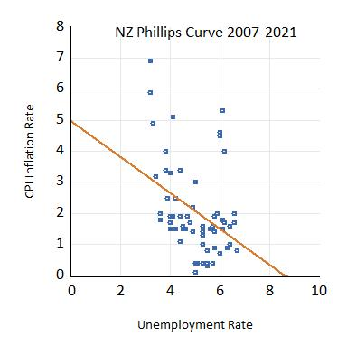
Inflation and employment
Higher employment (lower unemployment) may result in inflation

Slide 27
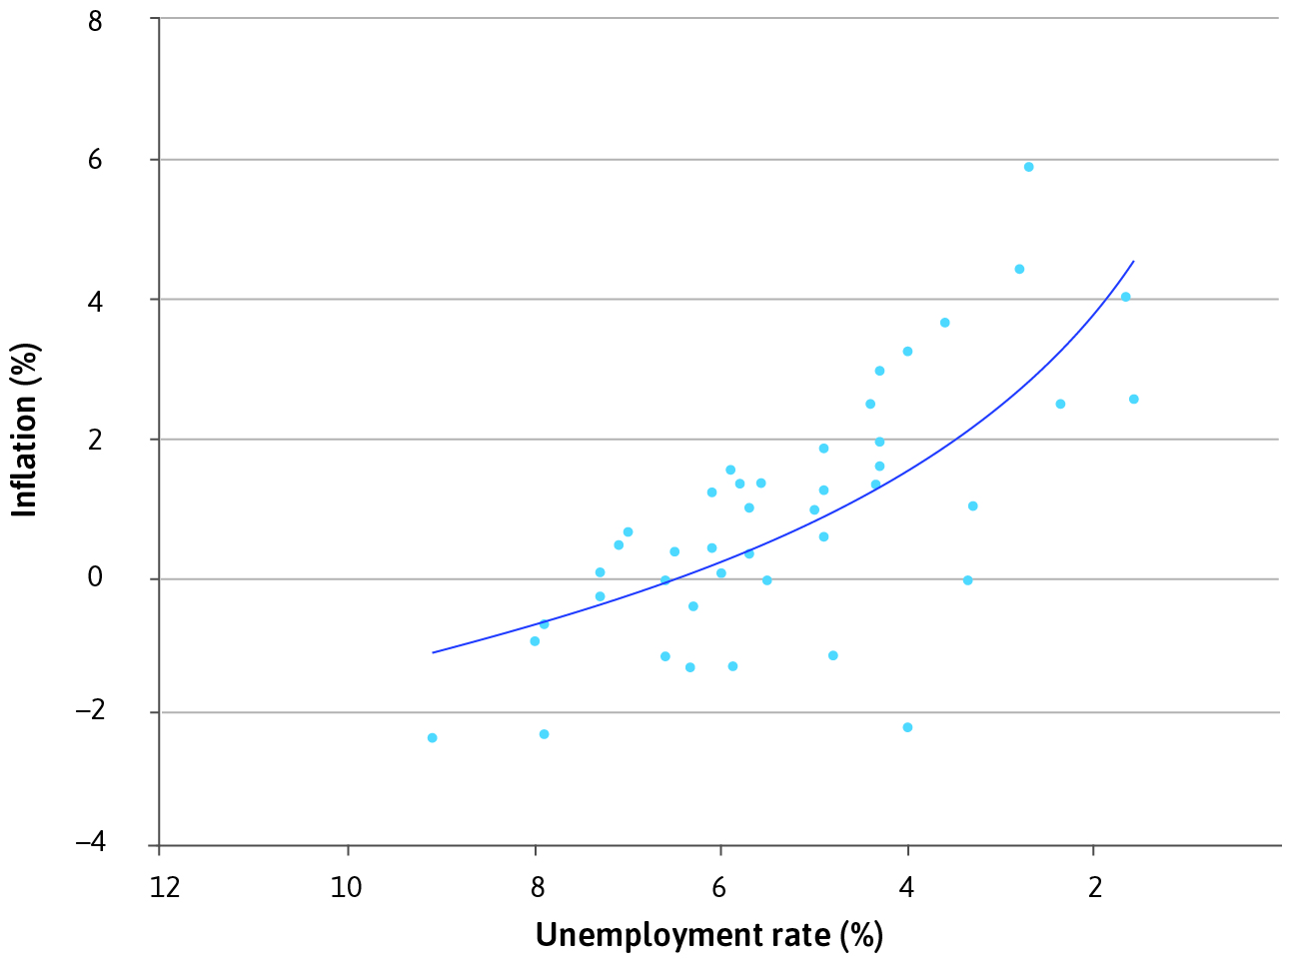
Inflation and employment
It increases workers’ bargaining position → higher wages → higher cost of production → higher prices
Note this graph reverses direction of unemployment rate from previous slide.
Watch unemployment (x-axis)

Slide 28
The nominal wage (W) adjusted to take into account changes in prices between different periods.
Definition: Real Wage

Slide 29
Wage Setting
Low unemployment leads to firms setting higher wages.
Higher wages = higher costs for firms
Firms raise prices
The price level in economy goes up.
Workers have more bargaining power.
Real wages are unchanged

Slide 30
Inflation and aggregate demand
An upswing in business cycle is often associated with rising inflation.
higher aggregate demand → higher employment → higher wages → higher cost of production → higher prices

Slide 31
Inflation and aggregate demand
Suppose economy experiences price and wage inflation, but the real wage (W/P) has not increased
constant real wage means that employment stays high …
wage-price spiral occurs

Slide 32
This occurs if an initial increase in wages in the economy is followed by an increase in the price level, which is followed by an increase in wages and so on.
Wage-Price Spiral

Slide 33
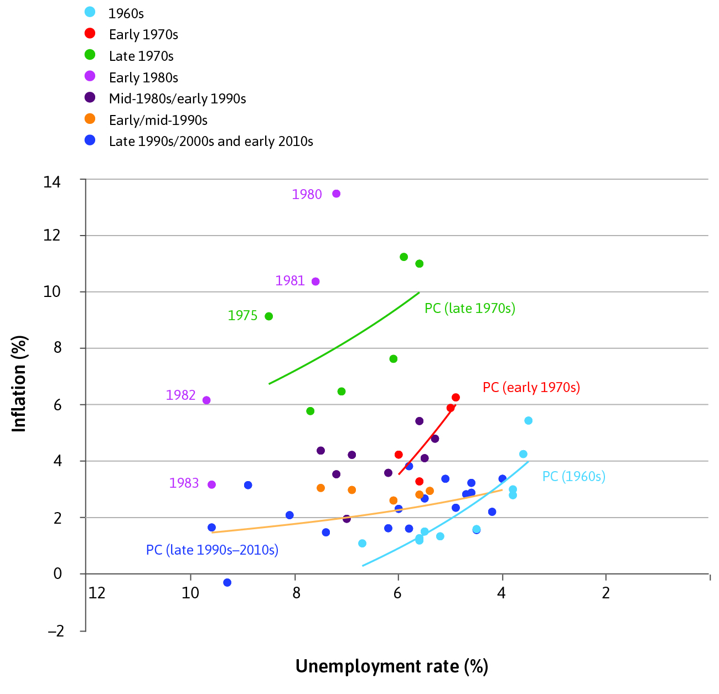
The Phillips Curve Over Time
Trade-off between inflation and unemployment is not stable:
Phillips Curve shifts over time
Keeping unemployment “too low” leads to higher prices
And hence rising inflation
There is only one unemployment rate at which inflation is stable.

Slide 34
Monetary Policy
02.

Slide 35
Monetary policy in New Zealand
The RBNZ has a dual remit for monetary policy:
Maintain price stability (keep inflation between 1-3% over the medium term); and
Support maximum sustainable employment (no target level)
Monetary Policy in NZ is conducted by the Reserve Bank of New Zealand (RBNZ)

Slide 36
Monetary policy in new zealand
Monetary policy is implemented by setting the Official Cash Rate (OCR)
The OCR is charged on Settlement Accounts Banks hold at the Reserve Bank
A Bank with a positive settlement balance is paid interest
A Bank with a deficit in its settlement balance is charged interest
Market interest rates are based on the OCR
The OCR is the policy rate referred to in your textbook.

Slide 37
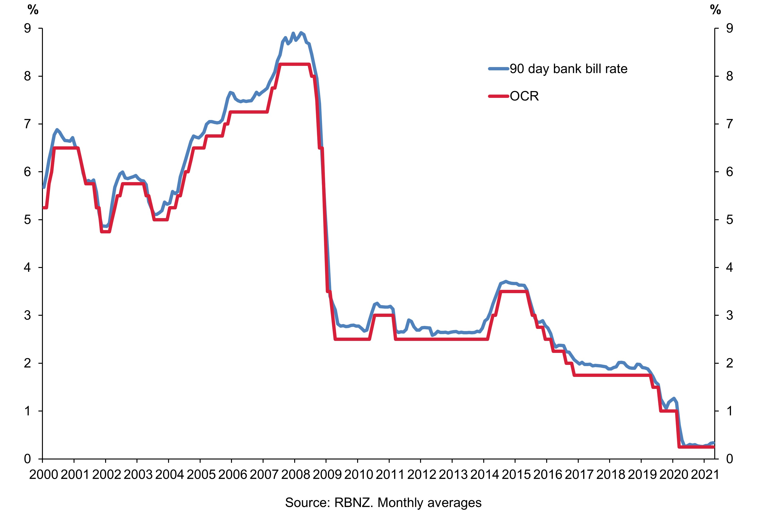
The OCR over time
Source: https://www.rbnz.govt.nz/monetary-policy/about-monetary-policy/what-is-the-official-cash-rate

Slide 38
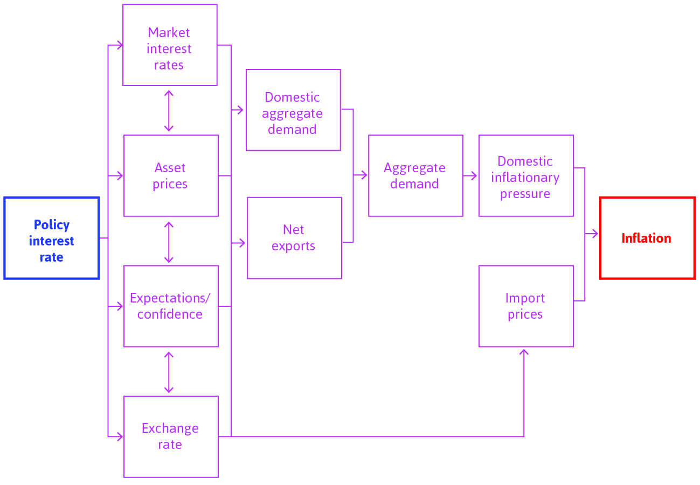
Transmission mechanisms
The Central Bank sets an inflation target (usually 2%).

Slide 39
Market interest rates
Choose the desired level of aggregate demand, based on the labour market equilibrium and the Phillips curve
Estimate the real interest rate, which will produce this level of aggregate demand (using the multiplier model)
Calculate the nominal policy rate that will produce the appropriate market interest rate.
To set the policy rate, the central bank will work backwards:

Slide 40
Asset prices
A change in the policy rate has a ripple effect through all the interest rates in the economy.
When the interest rate goes down, the price of assets goes up.
Households who own assets will be wealthier, which will increase their consumption.
Changes to the policy rate (OCR) affects asset prices.

Slide 41
Profit expectations
Consistent policymaking and good communication with the public builds confidence in the Central Bank.
This can lead firms to expect higher demand and therefore increase investment.
Households may be confident that they will not lose their jobs, and they may increase their consumption.
Confidence in the Reserve Bank is important.

Slide 42
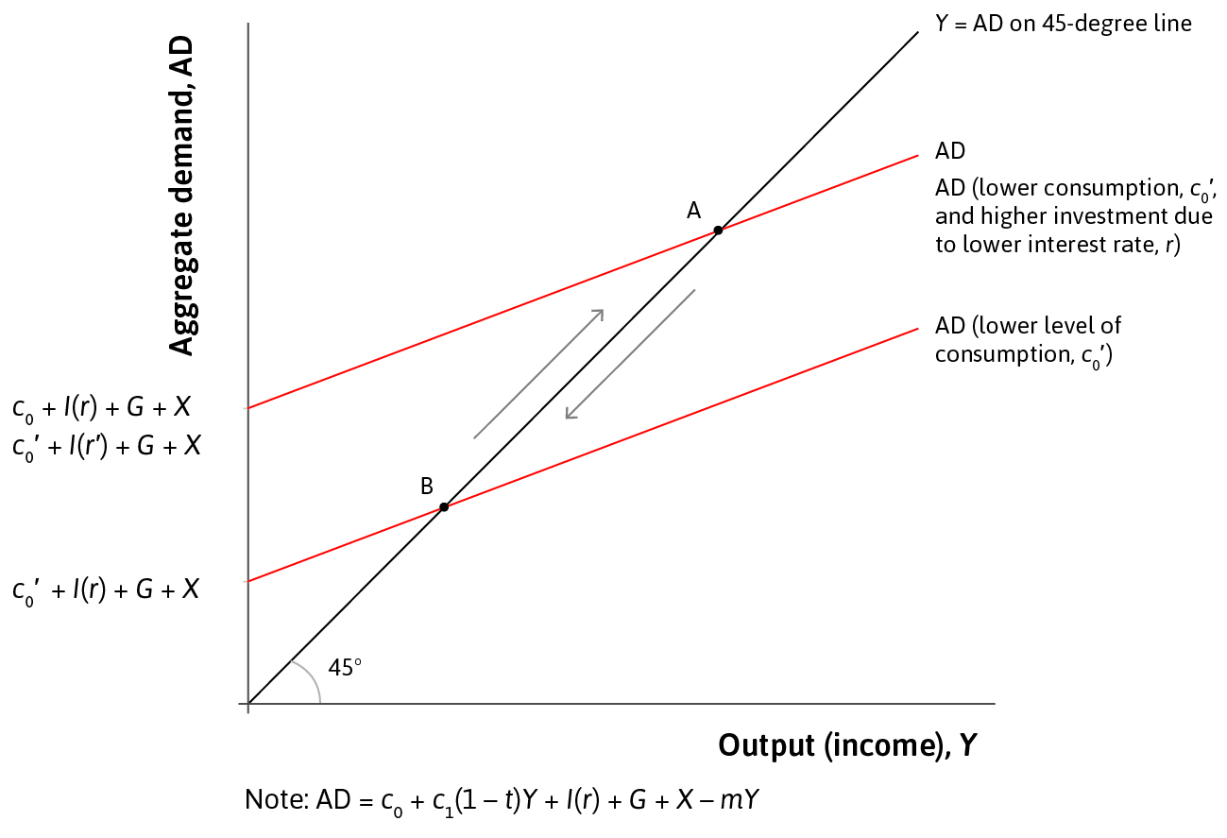
Monetary policy in the multiplier model
To stabilize the economy, the central bank stimulates investment by lowering the real interest rate.
This shifts the aggregate demand curve upward.

Slide 43
Monetary Policy: Limitations
The short-term nominal interest rate (policy rate) cannot go below zero (zero lower bound)
when the economy is in a slump, a nominal interest rate of zero may not be low enough to stabilize the economy
Monetary policy effectiveness can be hampered by two main issues.

Slide 44
Monetary Policy: Limitations
Countries that belong to a common currency area (or currency union) cannot set their own monetary policy.
E.g. The European Central Bank sets the policy interest rate for all countries in the Eurozone.
A country without its own currency does not have its own monetary policy

Slide 45
The Open Economy
03.
Exchange Rate Effects

Slide 46
Exchange Rate
Suppose someone in Sydney wants to buy 1 USD.
They need 1.2 AUD to buy this.
The exchange rate is 1.2/1 or 1.2
If the ‘price’ of foreign exchange rises, the currency has depreciated.
If the ‘price’ of foreign exchange falls, the home currency has appreciated.
The price of foreign currency in terms of buying one unit of foreign currency*
Unless you’re in NZ where it is quoted the wrong way!

Slide 47
Exchange rate
Interest rates affect demand for home currency in the foreign exchange market, so affects the exchange rate
The exchange rate affects relative demand for home-produced goods, so affects net exports.
Therefore, interest rates affect aggregate demand through the market for financial assets.
Interest rates affect exchange rates.
Exchange rates affect exports and imports.

Slide 48
Exchange rate transmission mechanism
Consider the case of a boom in the New Zealand economy (which creates inflationary pressures):
RBNZ increases the OCR
NZ financial assets become more attractive to international investors
Demand for NZD rises (as there is greater demand for NZ financial assets)
Value (price) of NZD increases – an appreciation of the NZD
Reduces demand for NZ exports (from overseas) and increases demand for imports (by NZers)
AD falls!
Monetary policy is more effective in an open economy.
Increases in interest rates reduce investment and exports.
Decreases in interest rates increase investment and exports.

